Slide 1
The Fretboard Trainer
By: Cai Parks, Ethan Ellis, Marlee Stonebraker, Matthew Allen, and Lakshya Bajaj

Slide 2
Framing the Problem
Through ethnographic research conducted via interviews, observations and literature reviews- the following major problems were identified:
Engagement
Portability
Cost
Learners easily lose interest due to monotonous and incentivised content
Carrying around huge instruments is a burden for the learner and can lead to disengagement
The price of instruments and lessons puts learners’ musical dreams out of reach

Slide 3
Stakeholders
Our stakeholders consisted of college students, current guitar players, intermediate guitar players, teachers, and young learners.
POV Statement: Young aspiring musicians need an affordable and engaging way to learn music because young people have trouble being engaged and learn at different paces than other people.
Why we chose guitar?
Notes:
Notes: Make POV bigger and text bigger
Bold keywords

Slide 4
Research
Erica:
A freshman student at Purdue university studying Elementary and Special Education,
explained how English and music correlate well together.
Scott:
A 20- year old man who plays the guitar and piano discussed the challenges he had with teaching himself on how to play each musical instrument.
Health and Wellness Study:
Participants in the research study reported positive effects in mental health, specifically in mental creativeness and clarity.

Slide 5
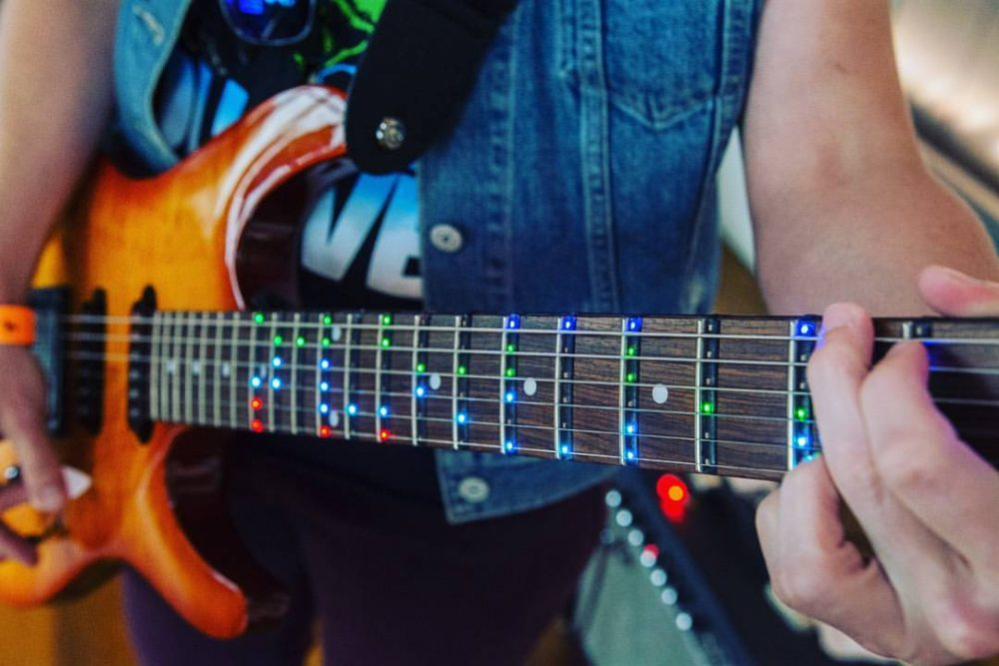
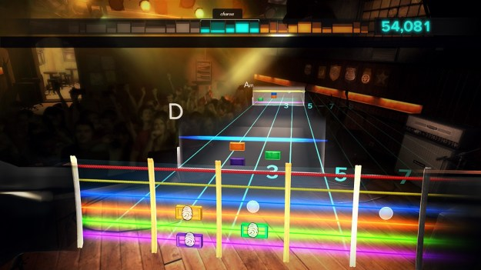
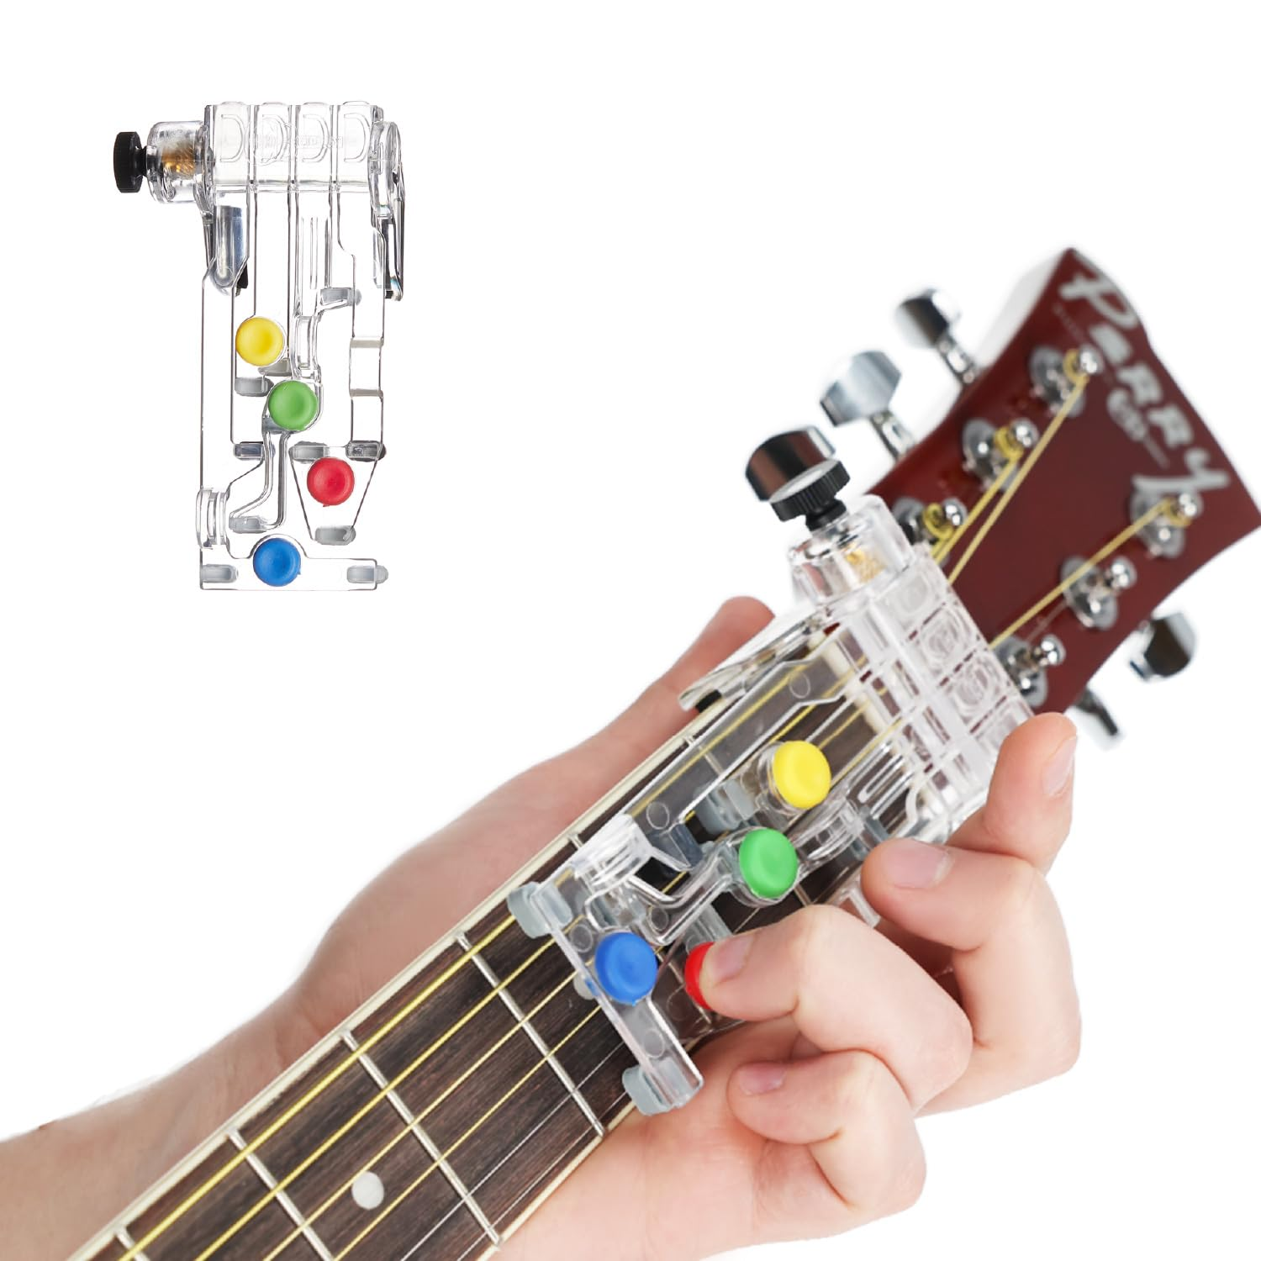
Existing Solutions-
Rocksmith - Guitar Video Game
Fret Zealot - Guitar Learning Tool
Chord Buddy
Notes:
We incorporated three of these solutions into our final solution so it is an adaptable, affordable, and well-functioning model.

Slide 6
Proposed Solution… Why?
Ease of Use
Affordable
Design was intuitive
Use of recycled materials
Accessibility
Engaging
Anyone can use
Keeps users wanting to learn
Notes:
Ease of use: The fretboard trainer is easy to understand, the user can choose the chord the want to learn and then it appears
Affordable: Recycled fretboards can be used from unused guitars, and same with the guitar strings. D’Addario is a guitar string brand that runs play back, the world’s leading string recycling program. We can reach out to them and see if they would be willing to give us some of those strings for us to used on our trainers.
Accessibility: Anyone who wants to learn a stringed instrument, no matter the age, can use this product
Engaging: The product will keep users engaged and they will want to keep learning.

Slide 7
Design Viability
Constraints:
Having excellent quality material for the fretboard
Durable long-lasting batteries and/or arduino nano chips
Functionable correlation with the LED lights
Criteria:
Having a functionable process of holding strings, LED lights, and chords in place
Adaptability
A cost-effective budget

Slide 8
Functioning Prototype

Slide 9
Testing and Data Collection
Test Groups:
Complete beginner
Intermediate guitar player (2 years)
Experienced guitar player (5 years)
Recommended Improvements:
Lack of budget
Chord name display
String tuning ability
Adding LED to all notes
Notes:
Testing was successful and went as expected. The trainer held together well, the strings stay in place, and chords appear in a random order. We tested with 3 subjects, from pure beginner to experienced guitar player. For the beginner, she found this device very helpful in practicing moving her fingers about the fretboard. She appreciated the LEDs making it easy to find finger placement. For the intermediate player, he enjoyed the product but found it easy. He would prefer to have an entire song to learn but this would require licensing which would cost more money. The experienced player found it useful to have a means to practice when he didn’t have his instrument, like if he were traveling. He did not really need the LEDs since he has a firm understanding of the theory already. There are some obvious improvements that could be made, but they would require more money and tools than we have at our disposal to make like…

Slide 10
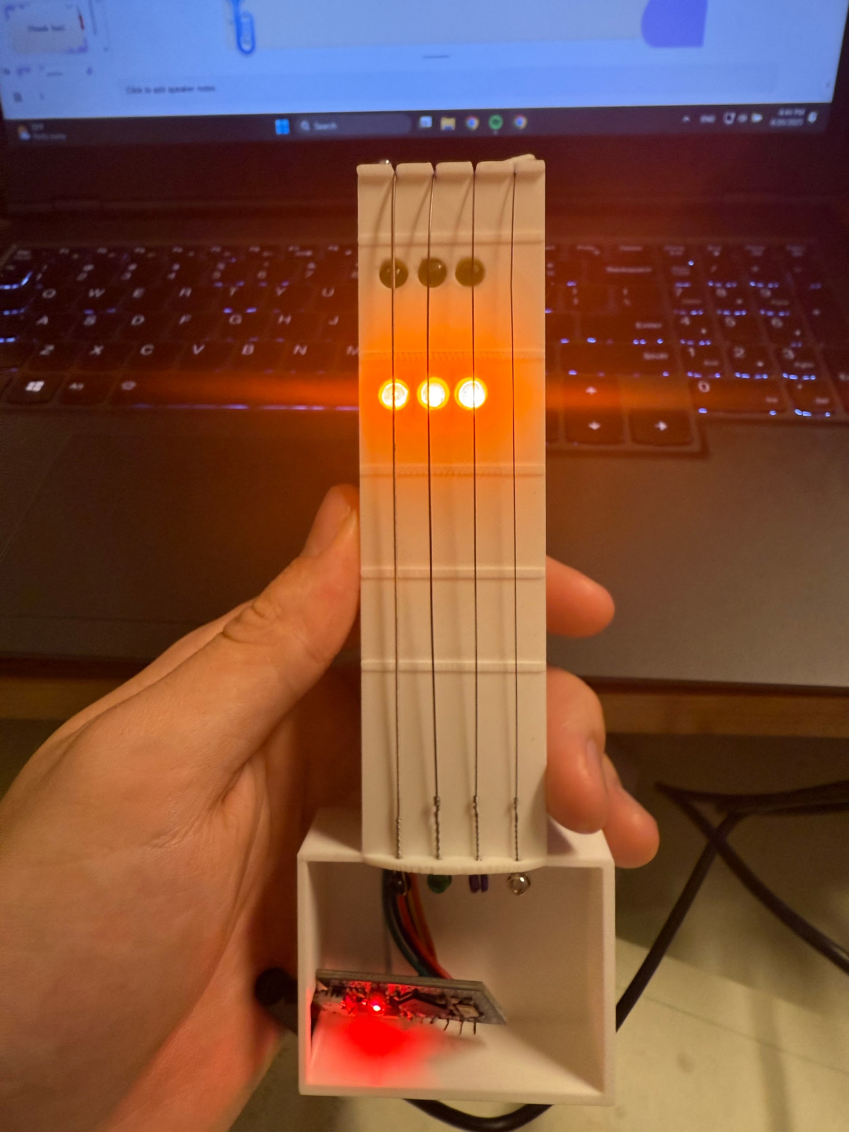
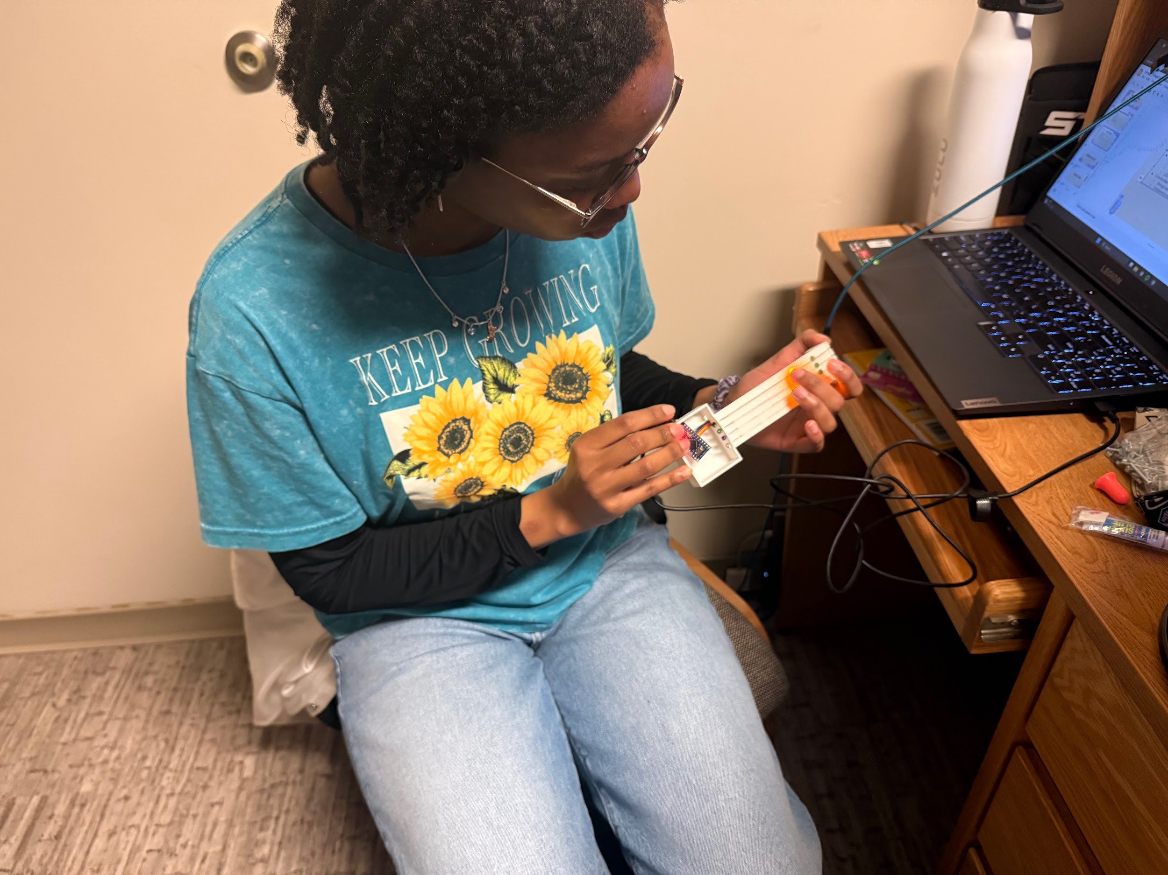
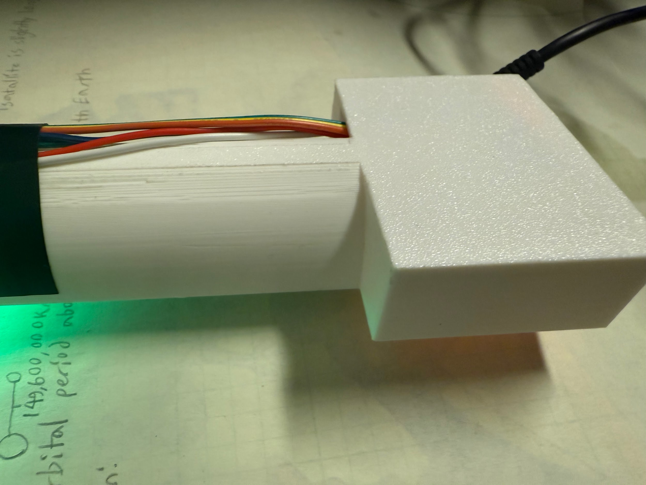
Data Analysis
Constraints Met:
Good quality and comfortable material
Power control
LED functionality
Criteria Met:
Strings are held in place
Fretboard is easily adaptable and customizable
LEDs functioning
Beginner testing
Smooth Print
Notes:
Our testing constraints and criteria wasn’t something that could really be measured by a graph, but more so checking for approval by the users. The quality came together quite nicely with a smooth finish on the 3D print. I thought the duct tape would be annoying during use but it actually proved to be useful like a grip without causing any discomfort. The electronics can be easily powered by plugging into any power source. Once improvement that could be made is adding a battery pack, but this would increase the size of the casing. The LEDs changed properly and have the capacity to have more chord shapes and even scales down to line. Although the strings are not tuned, they are held in place and return to a consistent position after being manipulated.

Slide 11
What’s Next?

Slide 12
If we were to continue building our product…
Design for Market
Create custom PCB and switch to smaller LEDs
Integrate wiring and develop more refined hardware
Add options for Guitar, Bass, etc.
Create interactive, personalized computer games that interface with the device

Slide 13
Thank You!

